Slide 1


Slide 2

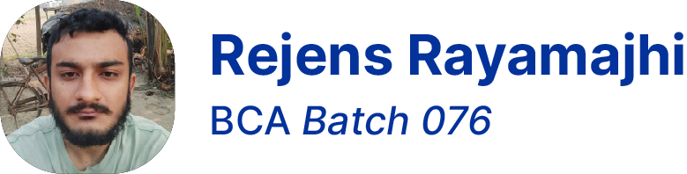
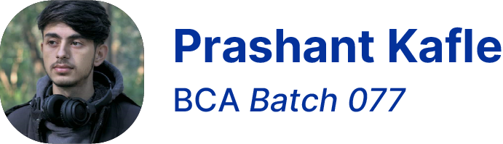
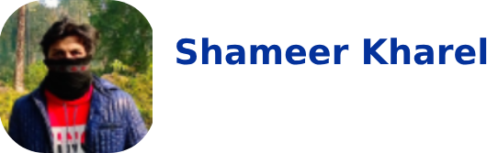


Hello! 👋
We are Mechi Mavericks ⭐
Full Stack Developer
Web/ ML Engineer
Full Stack Developer
AI Engineer

Slide 3


Slide 4


Slide 5


Slide 6
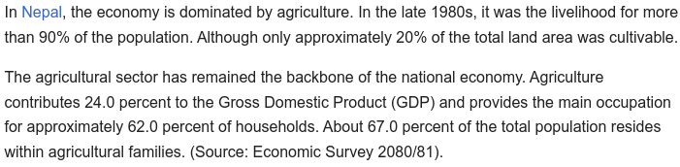
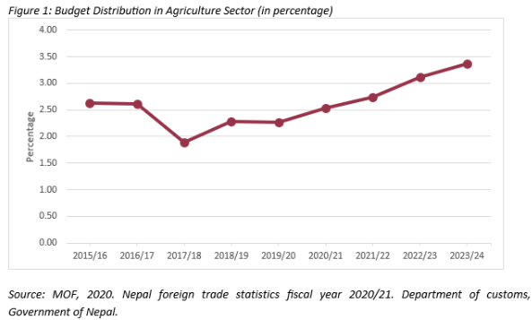
Source: MOF 2020. Nepal Foreign Trade Statistic Fiscal year 2020/2021 Department of Custom

Slide 7
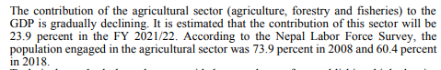
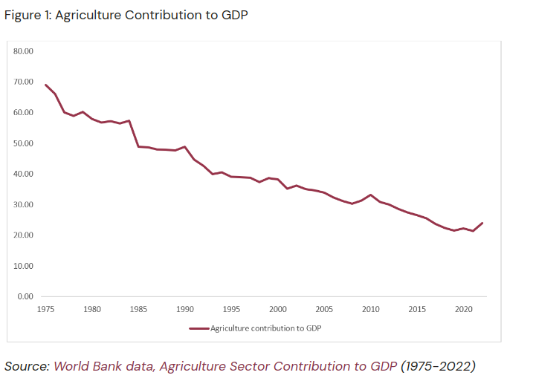
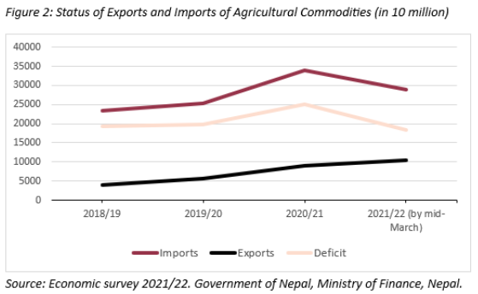
Source: World Bank Data, Agriculture Sector Contribution to GDP, Economic Survery 2021 Government of Nepal

Slide 8


Slide 9


What is निगरानी ?
निगरानी is a supervising system that looks out for the wild elephant invasion and swiftly alerts the villagers of the incoming danger.
It uses the combination of IOT and ML technologies and works as a unit.
It facilitates authorities to analyze the collected data for future reference.

Slide 10




How Feasible Our System is?
Technical Feasibility
Economical Feasibility
Operational Feasibility
Political Feasibility

Slide 11


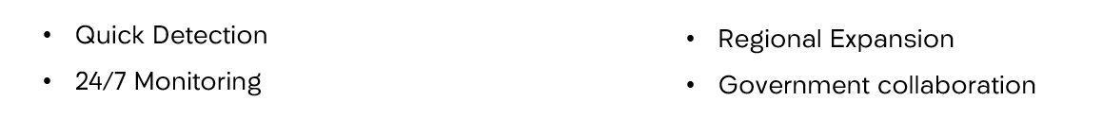


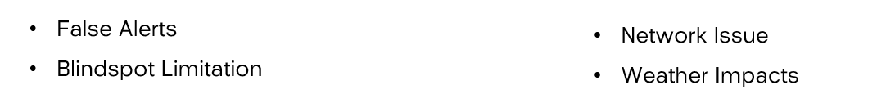
SWOT Analysis .
Strength
Opportunity
Weakness
Threat

Slide 12



Sustainable Development Goals that our project meets
09. Industry, Innovation and Infrastructure
16. Peace, Justice and Strong Institutions
11. Sustainable cities and communities

Slide 13

Market Size
Targeted towards communities and village with a Agricultural lands and there is a need for such a product due to decreasing interest in Agriculture Sector, the potential market size could be significant.

Slide 14

Business Model
Our platform would be community supported & community oriented. It would not be generating any active revenue. But we will be selling our project as a package, and charge some amount for maintenance.

Slide 15






Technologies used
Following Tech & Development Environments which would be used on our project.

Slide 16
Scalability and future plan.
Integration of new technologies (sensors) for more accurate data collections
Regional expansion in other affected communities with the success of pilot project
Continuous Data training for more advance disease detection model

Slide 17
Thank You 🙏
From Mechi Mavericks ⭐

